Slide 1
Lesson 00.03
Solving problems with contracts and variables

Slide 2
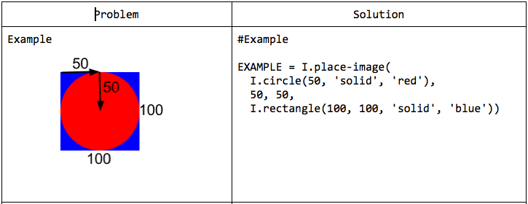
“Use the previous binding in your next solution”

Slide 3
“Use the previous binding in your next solution”
THIS IS A BINDING
IN A VARIABLE BINDING THE VALUE OF THE VARIABLE NEVER CHANGES. THE VARIABLE IS BOUND TO A CONSTANT

Slide 4
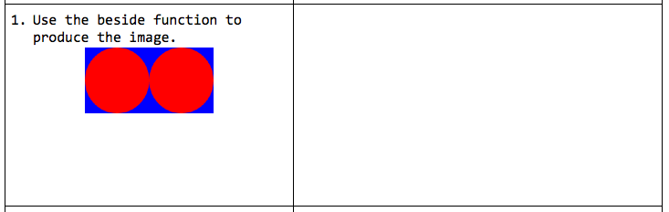
“Use the previous binding in your next solution”

Slide 5
“Use the previous binding in your next solution”
WHAT IS THE CONTRACT FOR THE BESIDE FUNCTION?

Slide 6
“Use the previous binding in your next solution”
EXAMPLE- = I.beside(EXAMPLE,
EXAMPLE)

Slide 7
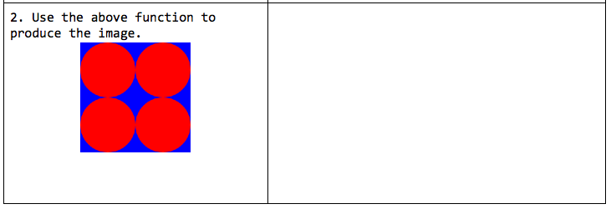
“Use the previous binding in your next solution”
EXAMPLE-1 = I.beside(EXAMPLE,
EXAMPLE)

Slide 8
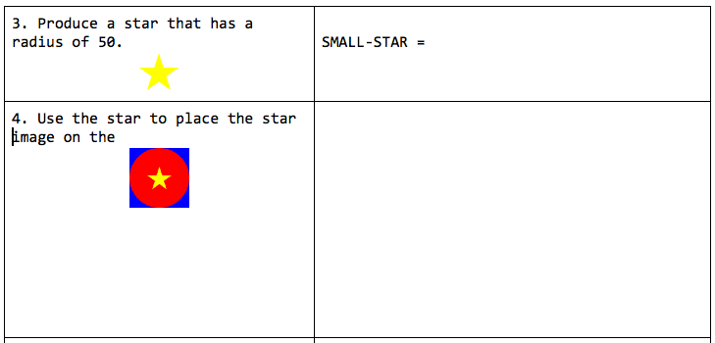
“USE THE PREVIOUS BINDING”

Slide 9
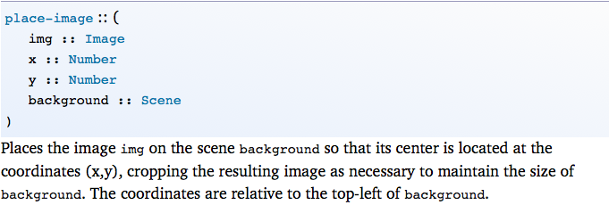
Contract for place-image
What type of thing place-image return?

Slide 10
Contract for place-image
IMAGE

Slide 11
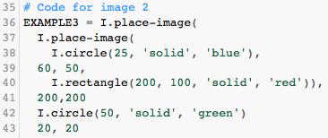
Help your classmates solve a problem
Copy and paste this code and debug it for your classmates
EXAMPLE3 = I.place-image(
I.place-image(
I.circle(25, 'solid', 'blue'),
60, 50,
I.rectangle(200, 100, 'solid', 'red')),
200,200
I.circle(50, 'solid', 'green')
20, 20

Slide 12
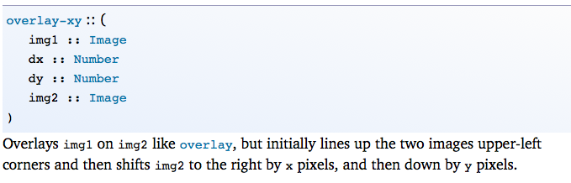
Compare overlay-xy to place-image

Slide 13
What is the contract for rotate?

Slide 14
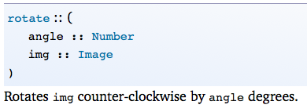
What is the contract for rotate?

Slide 15
What is the contract for rotate?
GO TO PYRET AND WRITE AN EXAMPLE OF ROTATE

Slide 16
Continue working with your partner on your Pyret classwork
Make sure you work in the file that I shared with you and your partner

